Slide 1
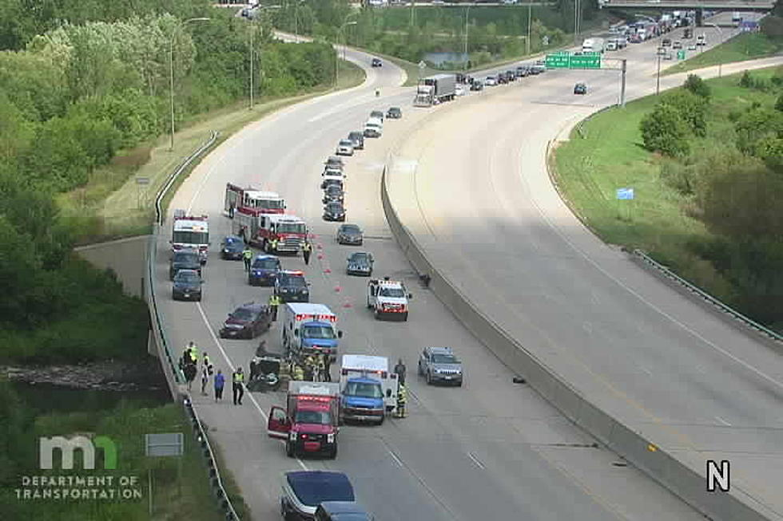

Traffic impact from us car accidents
By Zack DeNoto
https://townsquare.media/site/669/files/2020/08/D6-C011.jpeg?w=980&q=75

Slide 2

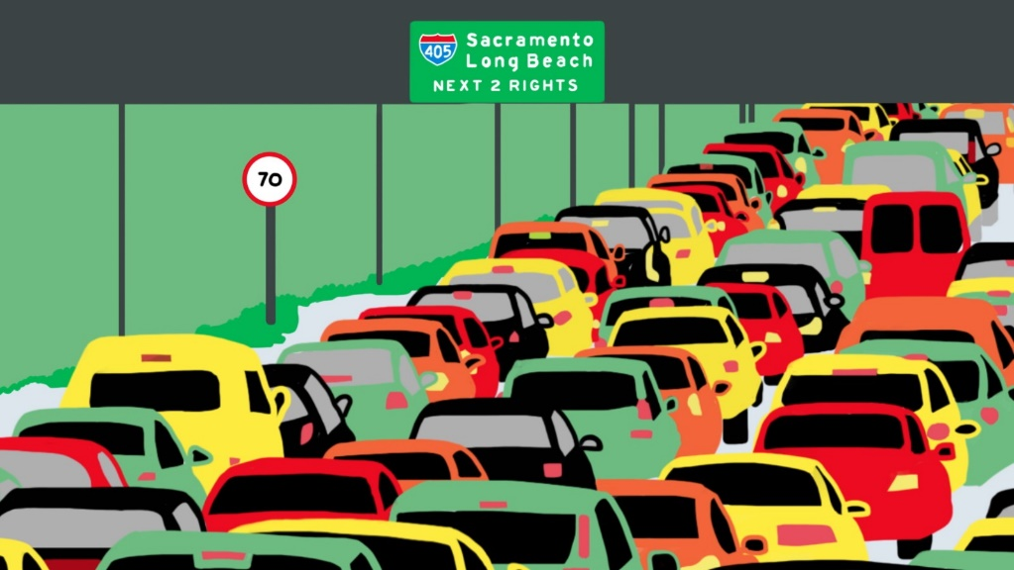
Intro/Hypothesis
US car accidents and Traffic
Biggest Factors
Can we predict traffic severity?

Slide 3
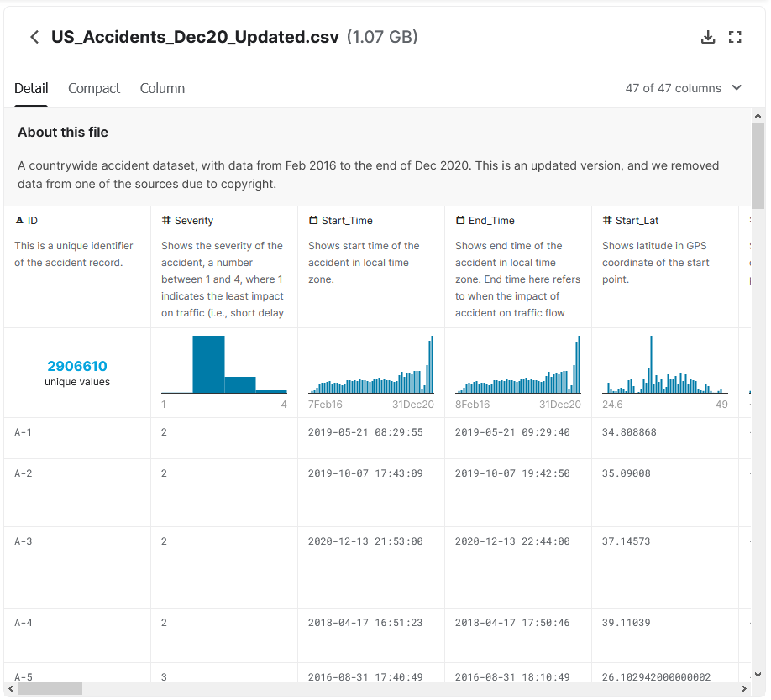
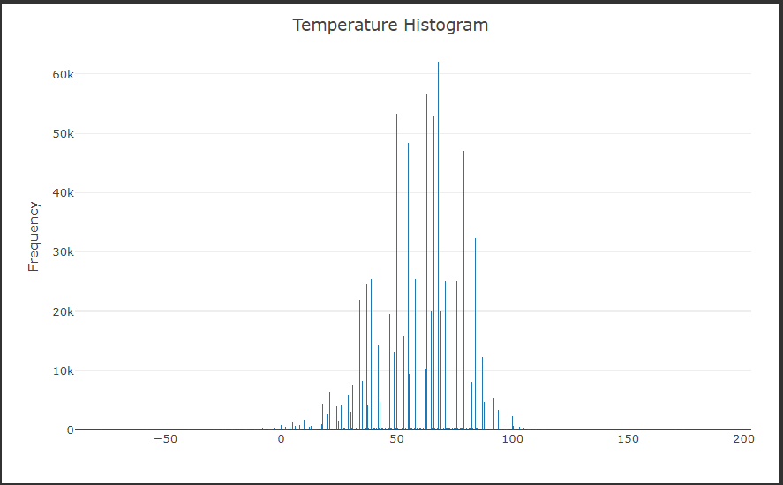
EDA
Dataset
Steps needing to be done
Challenges

Slide 4
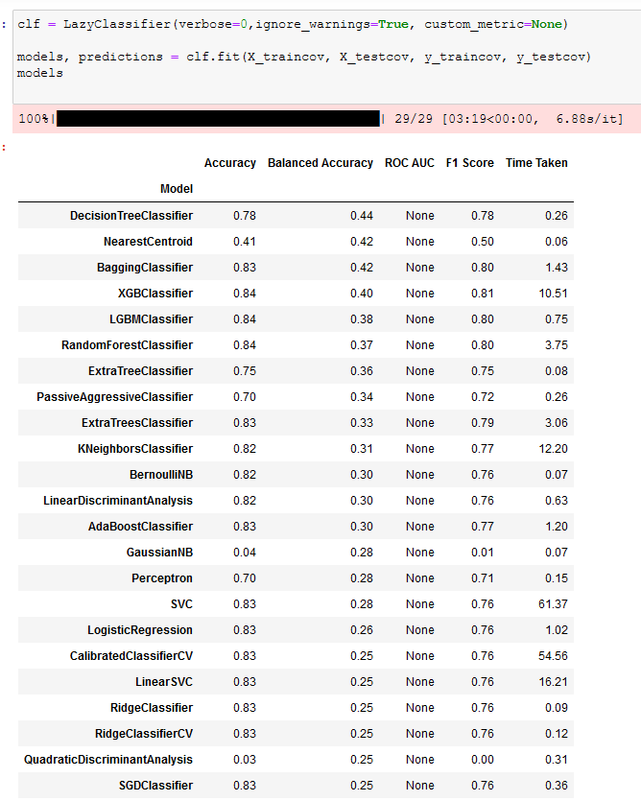
Modeling
Lazy Predict
Logistic Regression
K-Nearest Neighbor
Random Forest
Stochastic Gradient Descent
XGBoost

Slide 5
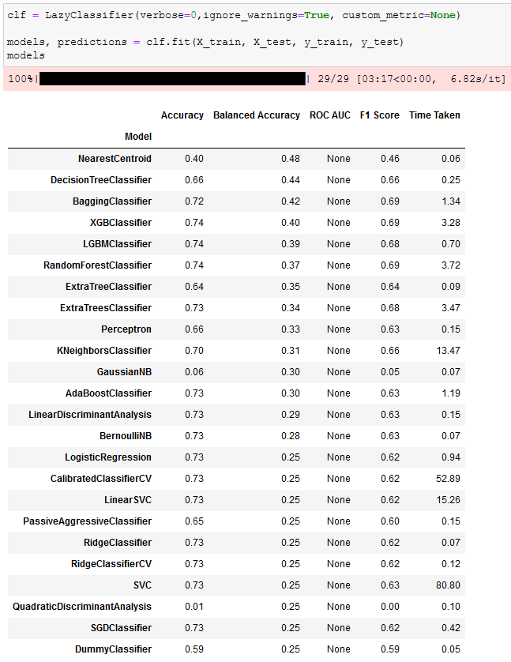
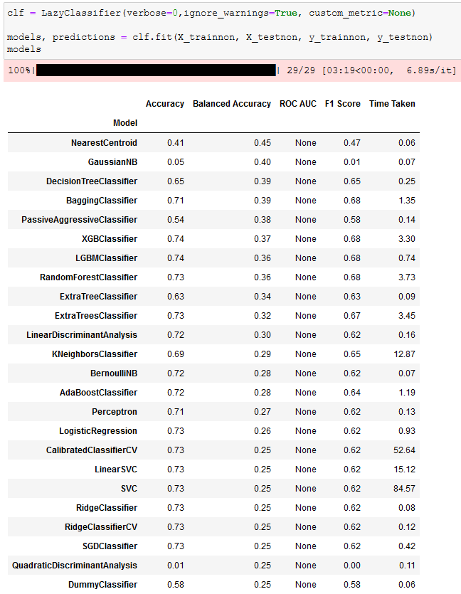
Modeling
Notes:
Texture mean on the right
Deep learning keras model for

Slide 6
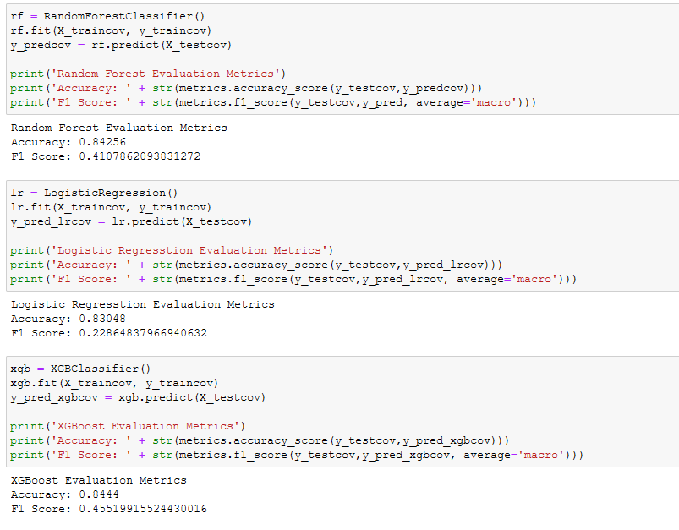
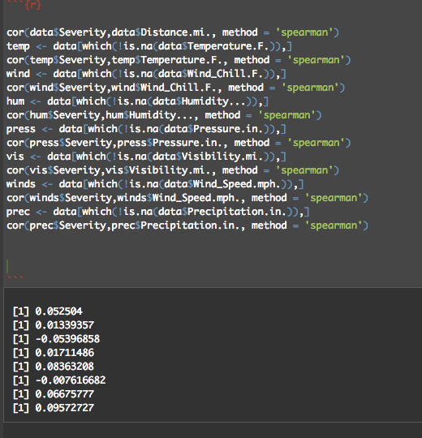
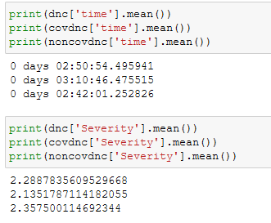
Results
Accuracy
Correlation
Factors

Slide 7


Conclusion
How can this analysis be improved?
US traffic and Covid-19

